Slide 1
Elements and Principles of Design
Elements and Principles of Design
Easton Nguyen
Graphics 1

Slide 2
Line
Line
Linear marks connecting two points.

Slide 3
Shape
Shape
A self contained, defined area. Can be geometric or organic.

Slide 4
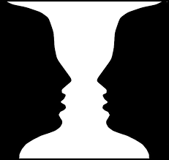
Space
Space
The area in or around an object.

Slide 5
Size and Form
Size and Form
How much space an object takes up.
Physical mass of an object.

Slide 6
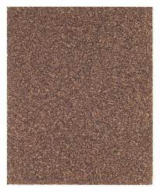
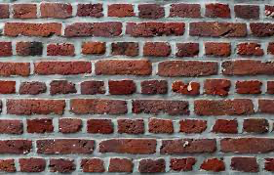
Texture
Texture
The look or feel of an object.

Slide 7
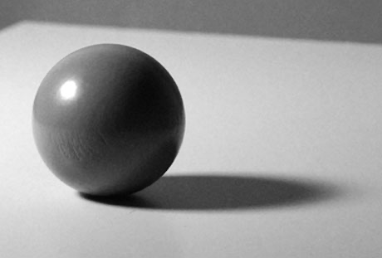
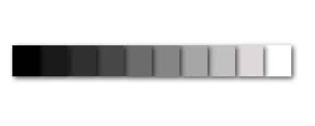
Value
Value
Lightness or darkness of a color. Tint means to lighten, shade means to lighten.

Slide 8
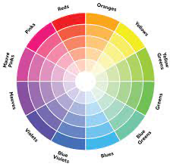
Color
Color
Frequency of visible light.

Slide 9
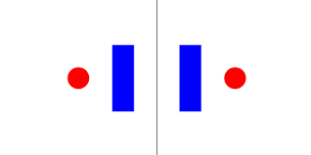
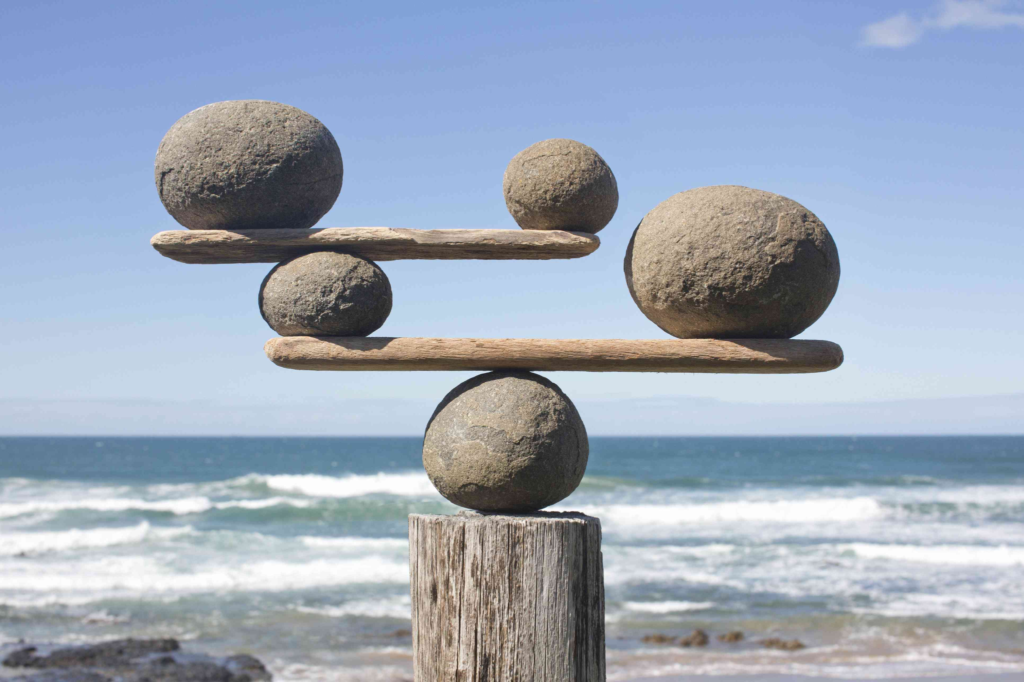
Balance
Balance
The distribution of visual weight or objects, colors, texture, and space.
Formal - Symmetrical
Informal - Asymmetrical

Slide 10
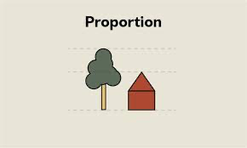
Proportion
Proportion
Relationships between, size, shape, and amount of something.

Slide 11
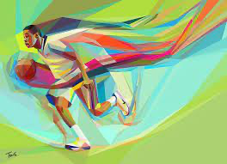
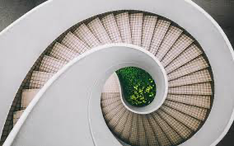
Movement
Movement
How your eyes move through the piece.
Shows physical movement.

Slide 12
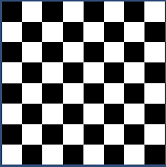
Unity
Unity
Elements are put together in a piece to make a sense of wholeness.

Slide 13
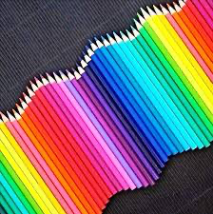
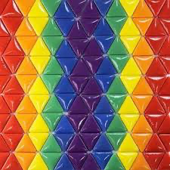
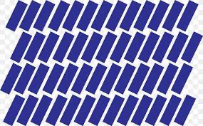
Rhythm
Rhythm
Repeating elements throughout a piece

Slide 14
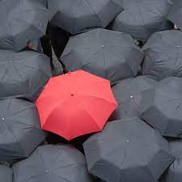
Emphasis
Emphasis
Attention to specific things.

Slide 15
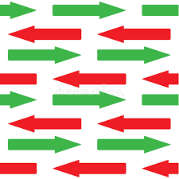
Contrast
Contrast
Opposites side by side.

